Slide 1
Our Journey to CPOE
Inpatient, Outpatient, and ED
ONIG AGM and Education Day March 6, 2015
Deb Karcz
Janine Riffel
Andrew Nemirovsky
Tina Holden

Slide 2
CPOE in the Inpatient and Ambulatory Areas
Deb Karcz, RN, Clinical Informatics Specialist
&
Janine Riffel, MRT, Radiation Safety Officer (formerly Ambulatory Track Lead)

Slide 3

Presentation Format Inpatient and Ambulatory
Project Structure and Timeline
Cultural and Practice transformation (People)
Planning and Design (Technology)
Workflow (Process)
Training and Education
Implementation
Lessons Learned

Slide 4
What is HUGO?
Healthcare Undergoing Optimization … optimizing patient safety and supporting continuous quality improvement.
There are four elements to HUGO:
Computerized Provider Order Entry (CPOE)
Electronic Medication Administration Record (eMAR)
Closed Loop Medication Administration (CLMA)
Electronic Medication Reconciliation (e Med Rec)

Slide 5
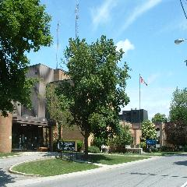
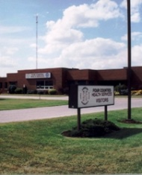
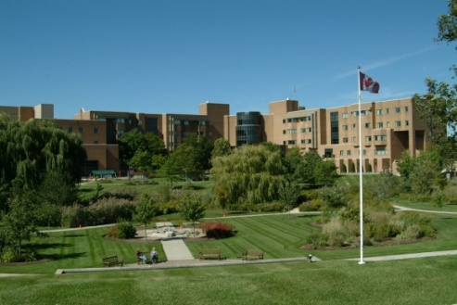
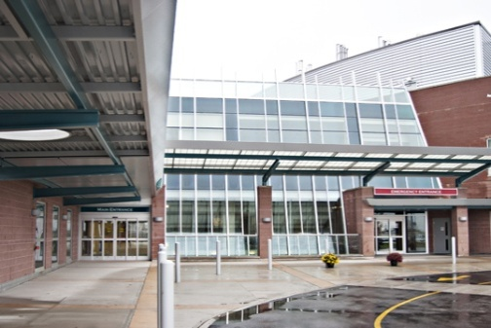
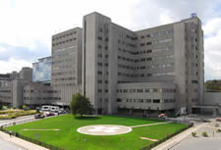
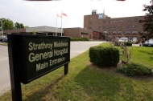

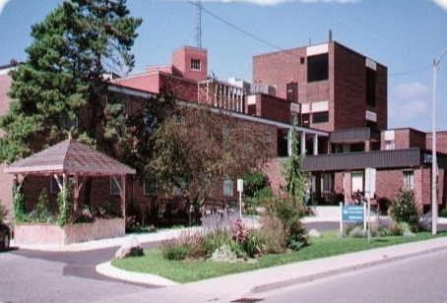


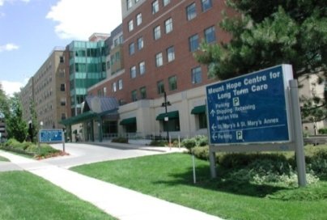

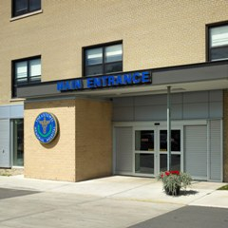



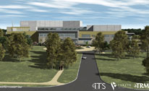

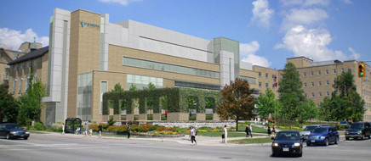
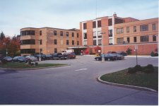
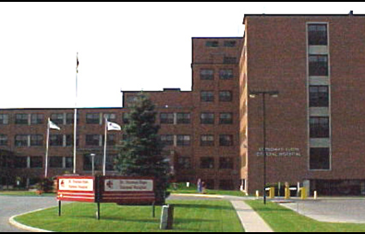
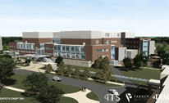
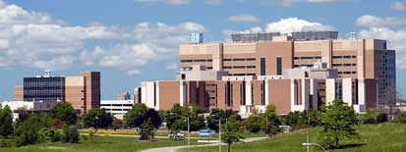
Participating Hospitals

Slide 6
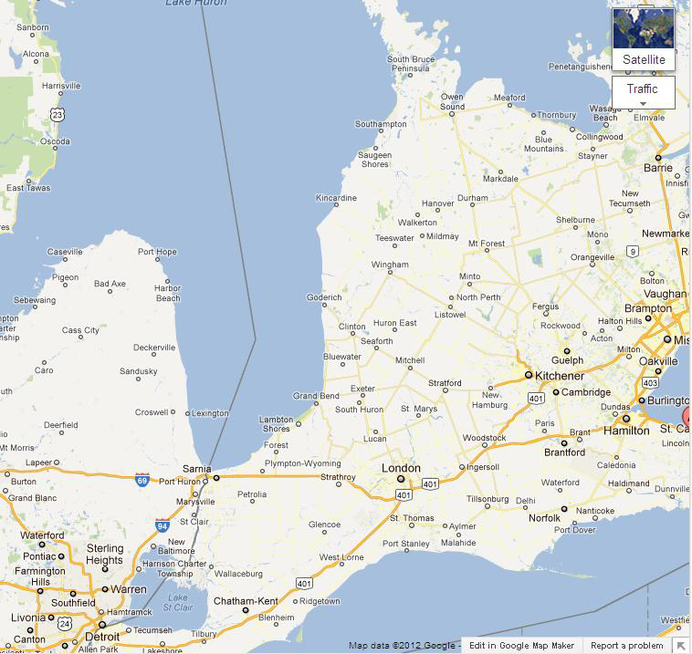
London Cerner Platform
Code Level 2012.30
Live with PowerChart, PathNet, RadNet, FirstNet, SurgiNet etc.

Slide 7
Project Structure
Project Sponsor/Executive Sponsor
  Project Manager + Regional Project Manager
    Track Leads ( Provider, Clinician, Ambulatory, Pharmacy and Education)
      Site Leads ( Regional + London Hospitals)
        HUGO + London Clinical Informatics Team
This structure allowed a collaborative approach to design and implementation decisions impacting Ambulatory and Inpatient areas.

Slide 8
Project Committee Structure
HUGO Steering Committee
Clinician + Provider Advisory Committee
Regional Professional Practice Group
Regional Pharmacy Group
Provider Engagement Group
Clinician and Ambulatory Group
Lab and DI groups

Slide 9

Project Timeline start to finish
Project Phase: April 2012-June 1, 2014
Go Live | Date | Hospitals
1 | November 2013 | 1 small community
2 | January 2014 | 3 small and 1 midsize community hospital
3 | February 2014 | 1 midsize and 2 small community hospitals
4 | April 2014 | 2 large acute care teaching 2 weeks apart
5 | May 2014 | 4 sites: large ambulatory, large rehab/complex continuing/palliative care/ 2 mental health
And then we rested….not so fast we are just getting started with the story

Slide 10

Together hugo transformed our world
“Every difficulty is an opportunity in disguise!”

Slide 11
Cultural & Practice Transformation (people)
Not just an implementation of new computer software, but rather a project implementing a change in culture and practice transformation.
Change leader on HUGO team, sessions offered for various levels of staff and areas
Focus on leadership and practice accountabilities and readiness

Slide 12

Cultural & Practice Transformation (people)
We are good at change! Or so we think….
Team too small to accommodate the massive change across many sites
Always another group we discovered as we went along
Engaging the not so engaged
Biggest piece of the puzzle with the least attention when deadlines are looming

Slide 13

Planning and Design (Technology)
We planned a system where practices were standardized across both the inpatient and outpatient areas.

Slide 14
Planning & Design: Success
Standardizing how we document for all type of patients
  Broad introduction of some elements of clinical documentation to support the following elements
    Medication History
    Medication Administration
    Medication Reconciliation (2012 Accreditation Standard for Ambulatory)

Slide 15
Planning & Design: Challenges
Different Catalogues:
  We have a different Inpatient and Outpatient Catalogue
    Saving of favorites in both catalogues
Encounter Issues
  Issues on how to manage recurring medications/labs for outpatients (not an issue for inpatients)
  Initiating orders on the wrong encounter

Slide 16
Planning & Design: Input of Endusers
Held a group of workshops with our HUGO leads that enabled us to better understand how the design we were creating worked
Challenge:
  These sessions were attended by HUGO leads and the focus tended to identify workflow for the inpatient side of the house versus the outpatient clinic
  Group were too big and members changed often
Success:
  Had the opportunity to engage teams ( Allied Health, Lab and DI ) from both inpatient and outpatient to weigh in on decisions
  Better understanding of complexity

Slide 17
Planning & Design: Integration testing
Project decision to do Integration Testing scripts early with the Regional sites separate from the London sites
Pros:
  Regional sites had excellent scripts and identified gaps early.
Cons:
  Not enough focus on Ambulatory workflow to test the system
  Build/design decisions and process work not complete

Slide 18
Planning & Design: Devices
The “sexy” in any project
Most sites chose their own depending on contractual obligations
Larger centres held vendor fairs and invited regional sites to observe
Most sites went with same scanner brand, some on the same WOW and mobile devices
Most providers wanted the iPad flexibility, unfortunately we couldn’t accommodate

Slide 19

Workflow (Process)
Standard workflows in Ambulatory are quite different from Inpatient.
Requested all areas to submit the standard current workflows

Slide 20
Workflow: Ambulatory
Success: Opportunity for organizations to better learn what practices are taking place in clinics and align with corporate policies.
Challenge: Each clinic tends to manage the relationship between the provider and their support staff differently

Slide 21
Workflow: Inpatient
Success:
  Have many years experience for Laboratory and DI order entry, good mentors
  People helping people, shining stars
  Able to leverage some workflow templates already in place from Cerner
Challenge:
  Difficult to standardize even when work is similar e.g. vital signs routine
  We are all special and we didn’t know what we didn’t know
  No time to get to some of the policies supporting the work

Slide 22

Training & Education
Massive Undertaking across 10 sites
  approximately 16,000 users
All training had requirement for completion or position not flipped to new HUGO world
eLearning and in class sessions modalities
Superusers and HUGO leads recruited to assist
Clinical Educators leveraged at larger centres

Slide 23
Training & Education: Scheduling of classes
Set up classes by position
  Outpatient nursing vs Inpatient nursing
  Medical Secretaries and Outpatient clerks together
  Allied Health
  Providers
In principle this worked, but staff still found some content not applicable
  For example how to chart medication CLMA vs direct charting off the eMAR

Slide 24

Training & Education
Successes
  Groups/Services set up training together
    Opportunity to discuss workflows
    Set up favorites
  Set up training and simulation rooms
    This enabled staff to practice prior to go live
  Superuser pre-conversion session
    Able to provide last minute information and opportunity to answer questions just prior to go live
  HUGO website

Slide 25
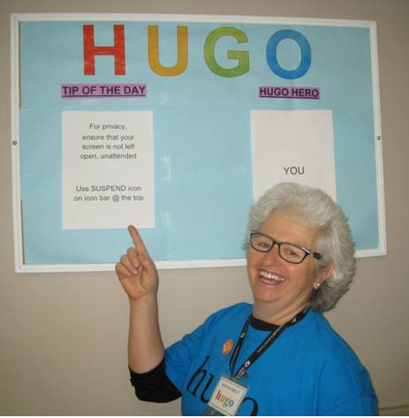
Training & Education: Quick Tips
We discovered at our first go-live that we need to create “quick tips” to support the end-users as they started to use the system.
Success:
  reinforced processes and help remind the end-users of frequently used scenarios
Challenge:
  Who did the work?
  By last conversion we
  had a rhythm with our education team

Slide 26
Training & Education
Challenges
  Training domain not updated
    Changes and updates were being made and the “gold” copy was cut earlier
  Focus tended to be geared towards inpatient
  Inconsistency in trainers
    Mixed messages
  Quick Tips
  HUGO website

Slide 27
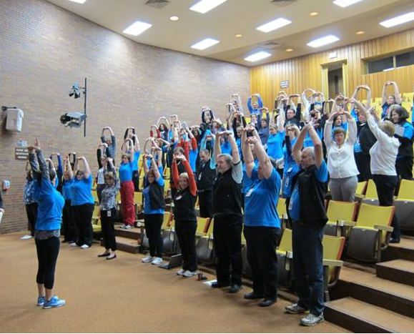
Implementation: The Importance of Resiliency
Staggered conversion and tight timeline
At one of our later conversions at the largest facility engaged our fitness team to de-stress the teams

Slide 28

Implementation
Successes
  We are live at 10 sites
  Better outcomes reported at initial site & LHSC with decreased medication errors
  Better partnerships across sites
  A better understanding of the
  complexity of the work
  Clearer picture of where we need
  to focus

Slide 29

Implementation
Challenges
  Not all decisions complete at go live
  Not all build complete at first go live
  Medication Reconciliation
  Process work not complete
  High incidence of multiple orders

Slide 30
Lessons Learned
Changed vendors after 1 year of planning
Need to have core group of trainers
Understanding your workflow is critical
Engaging all stakeholders with a plan
Engagement from the leadership all along the way is a key to success for the units
Sites with engaged professional practice leaders did better
Smaller staged approach

Slide 31
CPOE in the Emergency Department
Tina Holden, RN, Clinical Informatics Specialist
&
Andrew Nemirovsky, RN, Clinical Informatics Specialist

Slide 32
Background
11 Emergency Departments
1 Urgent Care Centre
174+ FirstNet Positions
360,000 total number of yearly visits
243 Emergency physicians
575 Emergency nurses
Notes:
Tina
2 level 1 trauma centres (adult & paediatric), a stroke centre & 8 regional emergency departments
London adult ED’s have a single group coverage model
Urgent Care Centre has full nursing clinical documentation
Hundreds of support staff
FC 10,000
WG 11,000
LM 14,000
AH 21,000
SM 25,000
TG 26,000
WH 30,000
UCC 34,000
Children's 36,000
STEGH 36,700
UH 50,000
VH 66,000

Slide 33
Exceptions to the Rule
One Emergency Department only implemented CPOE at point of admission decision – paper is used
Urgent Care Centre has had nursing clinical documentation since 2006
No CLMA
Notes:
Andrew/Tina
STEGH
Pay for results project at STEGH (best wait times in the province), did not want to implement and potentially lose funding
At the time of admit decision, the EP would then enter all admission orders and medication reconciliation
Approval required at the chief of staff/CEO level
UCC
Pilot
CLMA
- See next slide

Slide 34
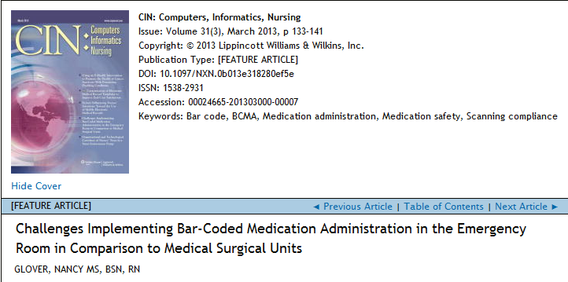
Exceptions to the Rule
Notes:
CLMA was not implemented for the following reasons:
Not widely used in the ED
An order had to be in the system before administering rendering verbal/medical directives difficult to carry out for emergency situations
Medications administered by physicians
Almost all medications are ordered as Stat, and are not scheduled for a certain time, making it very labour intensive for nurses (fewer medications administered at a time)
Study showed that 75% of medications administered in the ED involved just one medication, making it very inefficient
Cleaning/logging in at the wow, takes time for just one medication created twice as many steps to administer meds
Unpredictable workflow, high acuity, increased workload, alert fatigue and hardware limitations were all factors
Children’s ED limitations, bottles of elixirs created another barrier
Cook County had trialed and removed within the first week of implementation

Slide 35
Did Someone Say Clinical Documentation??
One single electronic triage assessment powerform that all sites shared
Quick Triage Registration
Enabled triage nurses to document allergies, BPMH, problems, initial and reassessment vitals
Pursuing implementation of Sepsis, Falls Risk and Suicide screening at triage using the triage powerform
Notes:
Tina
It was recognized early that the triage process was going to be a challenge if it remained half on paper, half electronic
A proposal was made to the Steering Committee to introduce clinical documentation at each site for the triage process to keep all documentation streamlined and facilitate the flow of information
Quick Triage Registration is done by either a registration clerk or nurse – site dependent and allows a patient to be registered and visible on the tracking board with minimal information
Allows us to now measure how long a patient waits to be triaged
- Triage Powerform Committee made up by end users

Slide 36
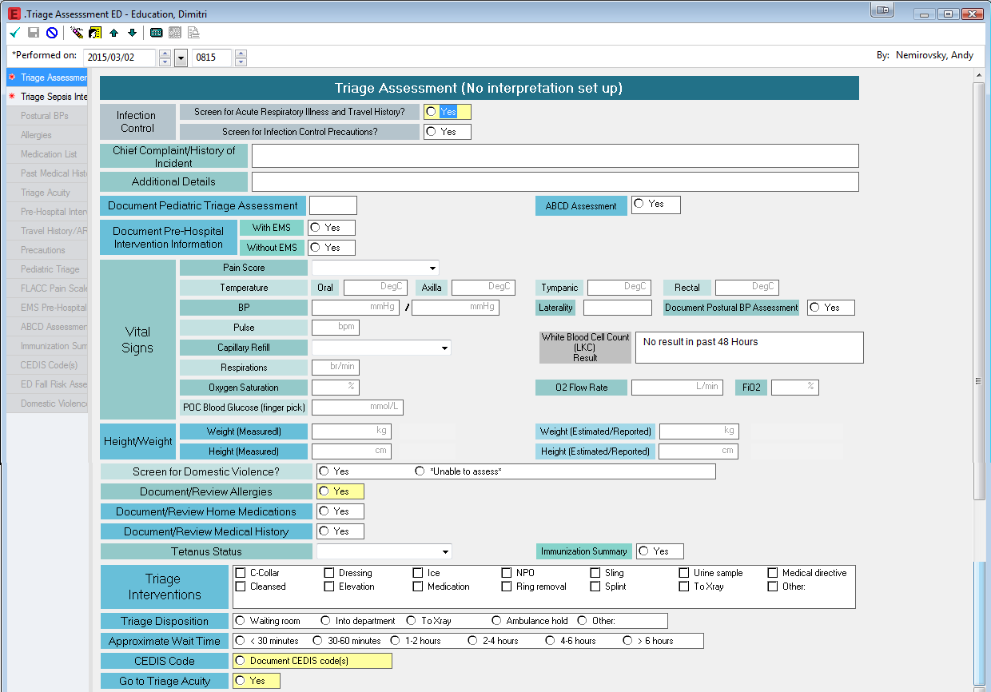
Triage Documentation

Slide 37
Tracking Board
Allows staff to track patients through the ED
New orders flagged to nurse/clerk once entered
Quick access to MAR and Vitals
Allows for communication between docs and nurses
Icons are used for Precautions, Referrals, and Orders (i.e. ECG and Radiology)
Lab and Rad order status

Slide 38
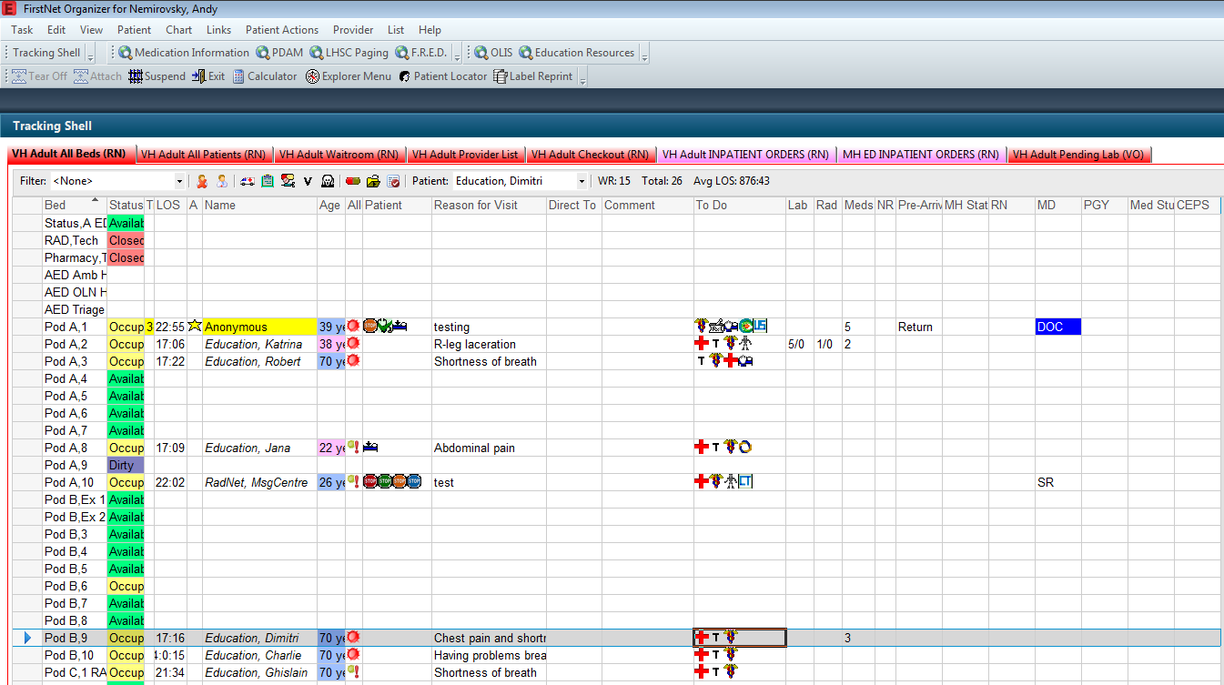
Tracking Board
Notes:
Tina
Very customized
Different tabs, filters and columns based on position
- Co-sign column on the physician view that indicates orders that need co-signature
Nurse Review column on the nursing view that indicates when new orders are entered or when order details are changed
MAR column to indicate number of medications to be given
“Yes, you have to look at the tracking board”

Slide 39
Who’s the Attending?
Programming team built a custom rule to update the Attending Physician
Pulls from the MD column on the tracking board and updates from Emergency, Physician to the actual attending
This ensures results are sent to the correct physician and also solves billing issues for our Radiologists
Notes:
Andrew
- Patient’s are registered under EP at sites with multiple EP coverage
- Programming rule developed to update the attending physician into the registration conversation instantaneously

Slide 40
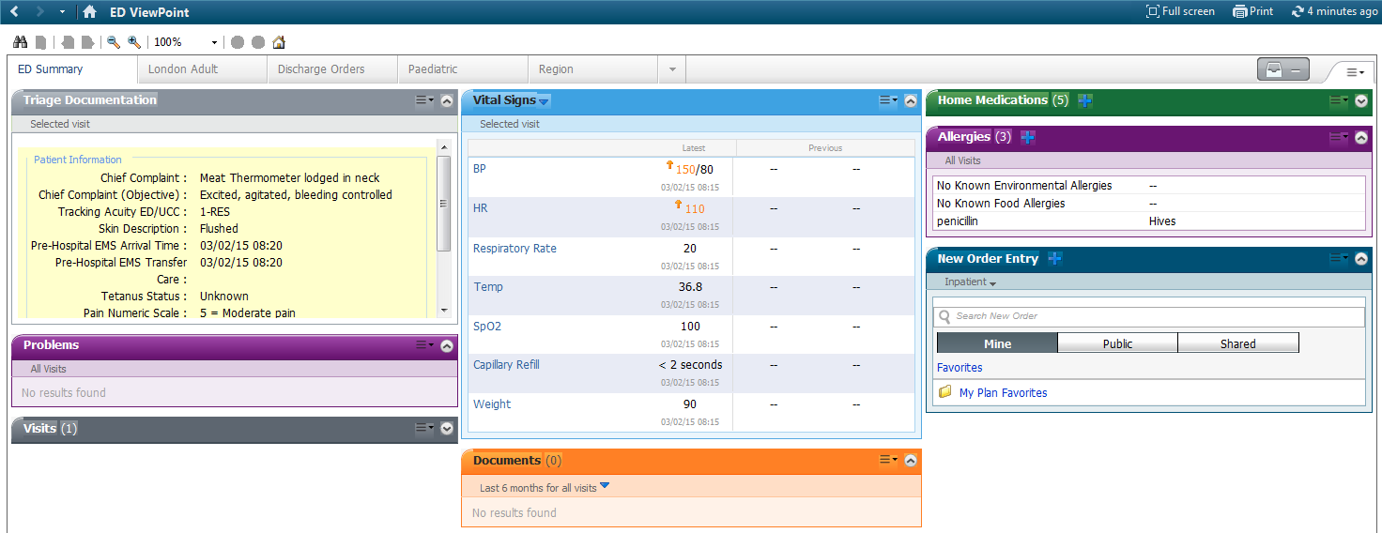
ED Summary mPage
Notes:
Tina
- Includes triage documentation and vitals

Slide 41
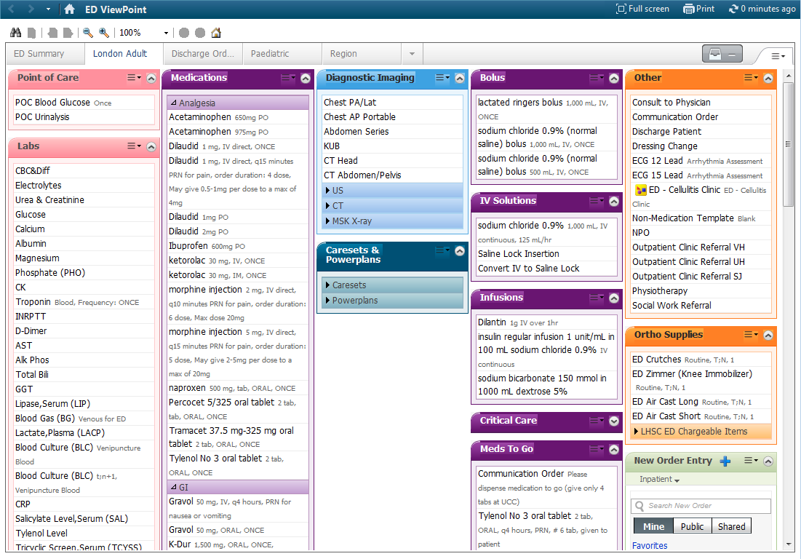
Quick Orders

Slide 42
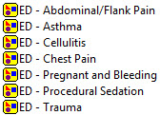
ED Powerplans
Symptom and disease based powerplans developed by ED group of providers
Blank powerplan - utilized as a catch all for follow up treatment that is customized to the patient
Disease based powerplans are ‘owned’ by services
Multi phase plans have more recently been developed, easing providers work and smoothing process for recurring medication administration (i.e. Rabies vaccinations, Cellulitis clinics)
Notes:
Andrew
example: DKA was developed and owned by Endocrinology, STEMI owned by cardiology
ED Cellulitis 5 day multi phase plan

Slide 43
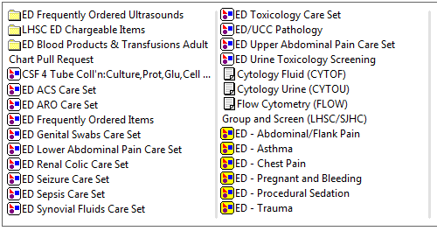
ED Caresets
Medical directive based care sets and common ordering practice based
Allows nursing to quickly enter orders when patients meet criteria
Reduces errors and speeds up entry

Slide 44
Trauma/Resuscitation
Paper
No back entry of data
Clerk order entry (laboratory and diagnostics only)
Notes:
Tina

Slide 45
The Barriers
Encounter based system
Regional admission workflow
Multiple Label Printers
Position Build and Maintenance
Devices to support ED workflow
Order Catalogue
Notes:
Andrew
Encounter based system causes issues for providers - have to be aware what encounter they are on as we keep both open for reporting purposes and to match current build
Regional admissions have different processes at some sites - causes confusion
Multiple label printers don't print properly with our current setup, providers are forced to pick which printer to send labels to - causing much frustration
Position build - Currently have almost 170 Firstnet positions - This is due to current design of Firstnet and multiple combo positions all requiring their own build
Proposal vs. On Hold orders for Medical Students - Currently we can only show On Hold orders on the tracking board in their own column as a visual cue for our Attending ED docs. Cerner is fazing out Med Student on Hold, so we will have to readdress in near future. Need to see what Proposed Powerplan functionality looks like and may be able to go to Proposed only
Needed to better review devices specifically for ED workflow. Mobile is nice but needs to be big enough to see, keep connection and have a keyboard and ideally a mouse.
Order Catalogue - Cannot stress enough how important it is to get your order catalogue cleaned up before implementing CPOE.
Favorite Sharing and Mpages - On 2012.01.13 code level their are many defects in regards to mpages and favourites. Essentially cannot use mpage and favourites for single orders - this is to be rectified with code upgrade in fall to 2012.01.30

Slide 46
Education
De-centralized from corporate training to accommodate schedules and unique tools used by much smaller group of staff
Localized to each site to include local workflows
Train the trainer model used to encourage end-user adoption of new tools and processes
Online FirstNet modules are used for rotating residents – developed with much provider input

Slide 47

Thank you and Questions
Contacts
Debbie.Karcz@lhsc.on.ca 519.685.8500 Ext 74700
Janine.Riffel@lhsc.on.ca 519.685.8500 Ext 76576
Andrew.Nemirovsky@lhsc.on.ca 519.685.8500 Ext 64094
Tina.Holden@lhsc.on.ca 519.685.8500 Ext 34209

